Slide 1
REAL-TIME STREAMING APPLICATION
Computer Networks - Assignment 1 (Semester 211)

Slide 2
Team members
Nguyễn Hoàng - 1952255 (CC05)
Nguyễn Thanh Ngân - 1911667 (CC01)
Phạm Nhựt Huy - 1952059 (CC05)

Slide 3
REQUIREMENT ANALYSIS

Slide 4
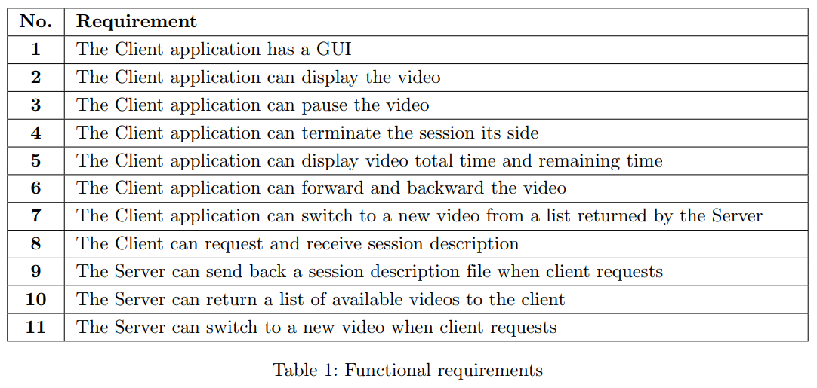
Functional Requirements

Slide 5
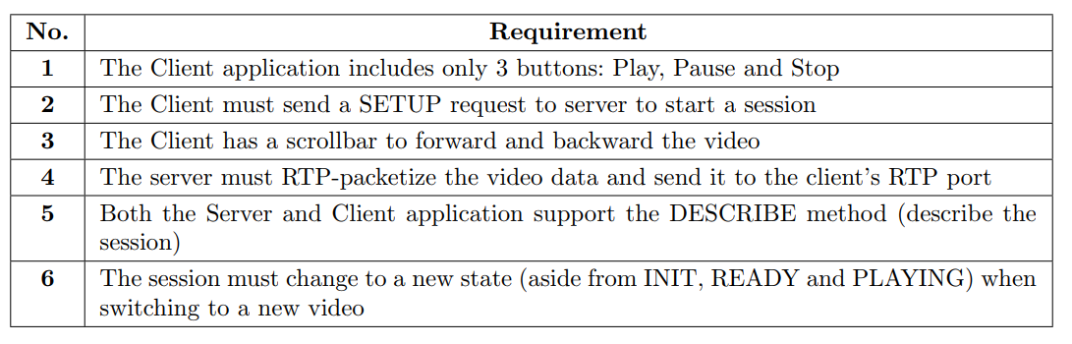
Non-functional Requirements

Slide 6
COMPONENTS

Slide 7
List of Components
Client application:
Graphical User Interface (GUI)
RTP packet receiver
Video renderer
Server:
RTSP request handler
RTP packet sender
RTP packet handler (packetization & de-packetization)
Video stream

Slide 8
DATA FLOW

Slide 9
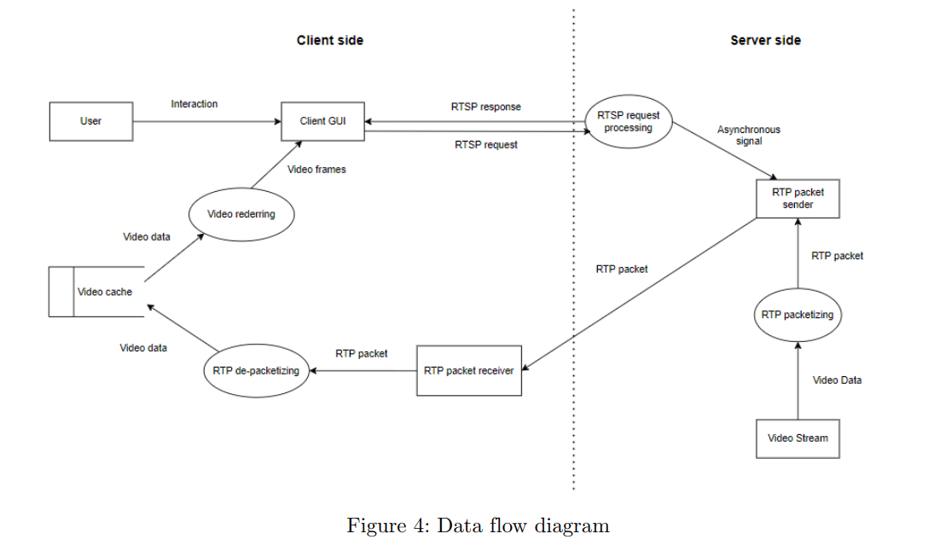
Data Flow Diagram (DFD)

Slide 10
CLASS DIAGRAM

Slide 11
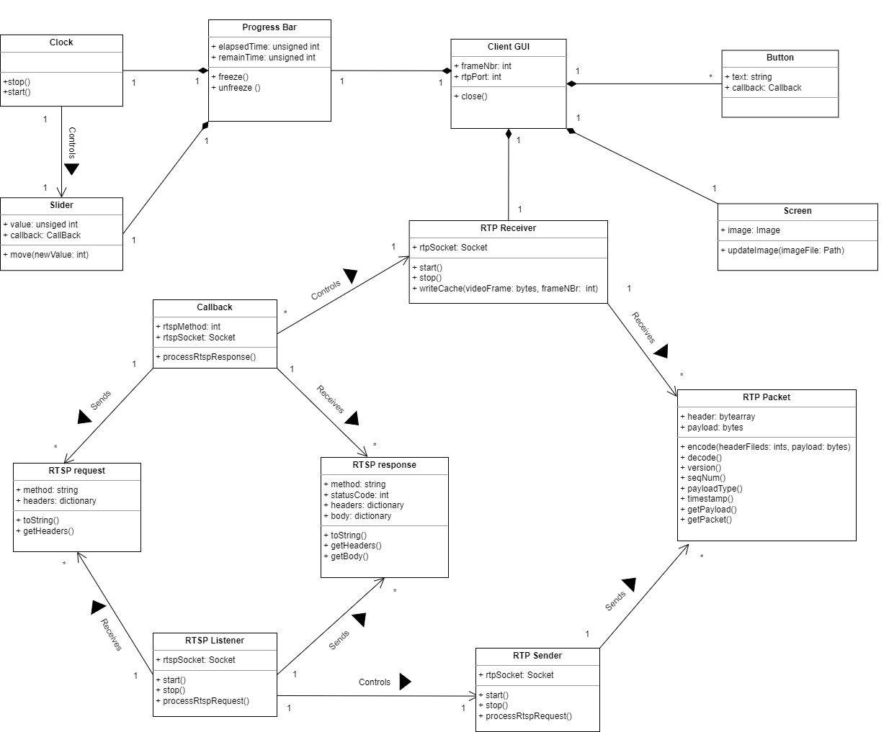
Class Diagram

Slide 12
APPLICATION DESCRIPTION

Slide 13
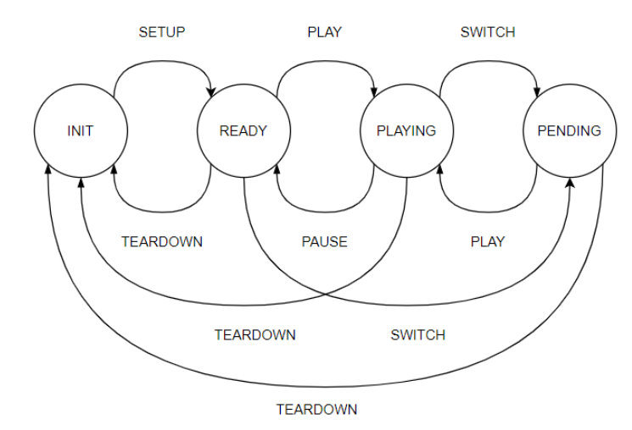
RTSP Methods
& States
SETUP
PLAY
PAUSE
TEARDOWN
FORWARD
LIST
DESCRIBE
SWITCH

Slide 14
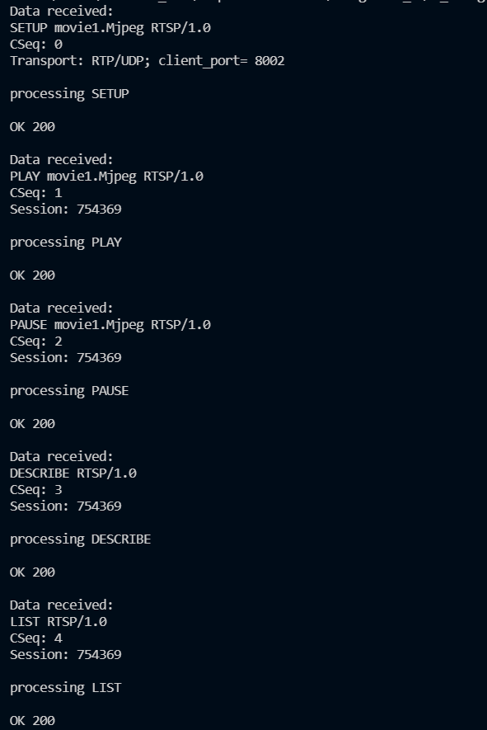
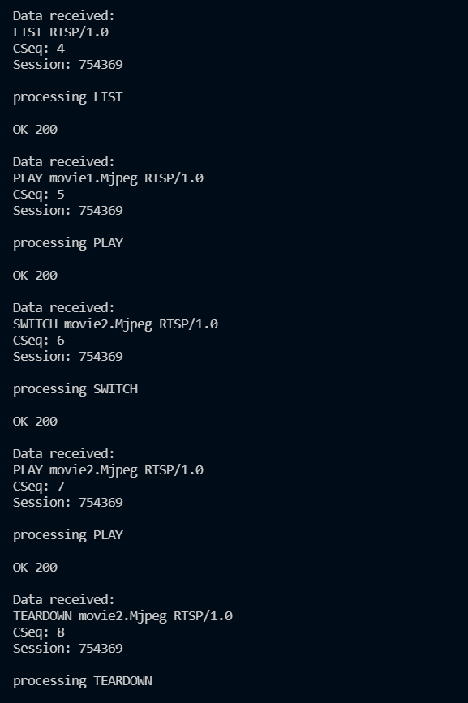

Slide 15
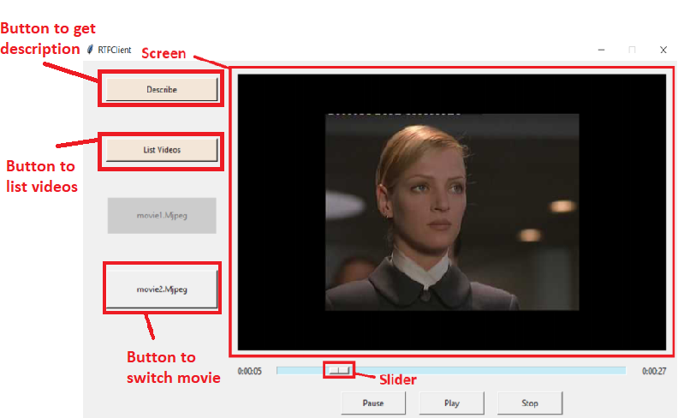
Graphical User Interface (GUI)

Slide 16
Functionalities
Playing video
Pausing video
Forwarding and backwarding video
Terminating session
Requesting session description
Listing available videos
Switching to a new video

Slide 17
Session Description
Session Description Protocol (SDP) - RFC 8866
v = (protocol version number, currently only 0)
o = (owner/creator and session identifier)
s = (session name)
a = (zero or more session attribute lines)
t = (time the session is active)
m = (media name and transport address)

Slide 18
Session Description - Example
v=0
o=elnosabe 2890844526 2890842807 IN IP4 126.16.64.4
s=Mjpeg Video Stream
t=2873397496 2873404696
a=recvonly
m=video 8002 RTP/AVP 26

Slide 19
APPLICATION USAGE

Slide 20
Command lines
# Install required dependencies
pip install -r requirements.txt
# Start the server
python Server.py <Server's RTSP port>
#Start the client
python ClientLauncher.py <Server's address> <Server's RTSP port> <Client's RTP port> \
<name of video>

Slide 21
DEMO

Slide 22
EVALUATION

Slide 23
Statistics
Frames per second
Packet loss rate
0.062
0

Slide 24
Thank you for your listening!

